Slide 1
Week 1
By Ayesha Manzer

Slide 2
Agenda
Introduction (course and me)
Addenda
Connection with Oracle
KEY TERMS:
Keys, Relationships, and Referential Integrity
What is data management?
What is database?
What is database management system (DBMS)?
Role and advantages of DBMS.

Slide 3
Data vs Information
What is data?
The use of data
Organization of data
Database, tables, columns and rows
What is information?

Slide 4
DBS 211 course website.
http://dbs211.ca/

Slide 5
How to connect to SQL Developer
https://myapps.senecacollege.ca/
You can find Login and Password on BlackBoard under My Grade

Slide 6
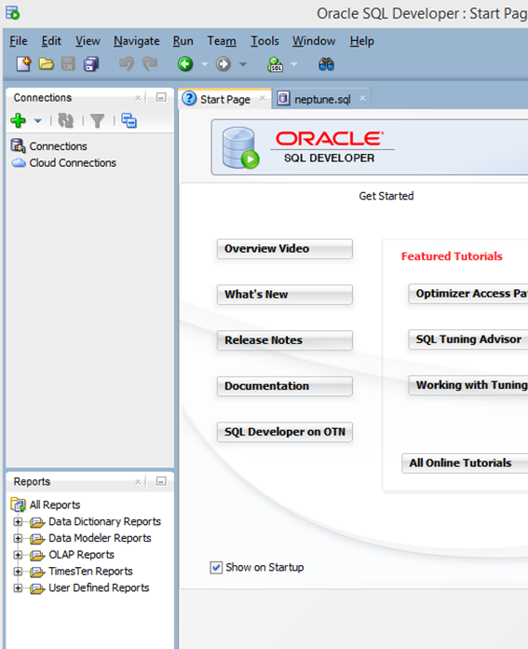
SQL Developer
Click on the green PLUS to create a new connection.

Slide 7
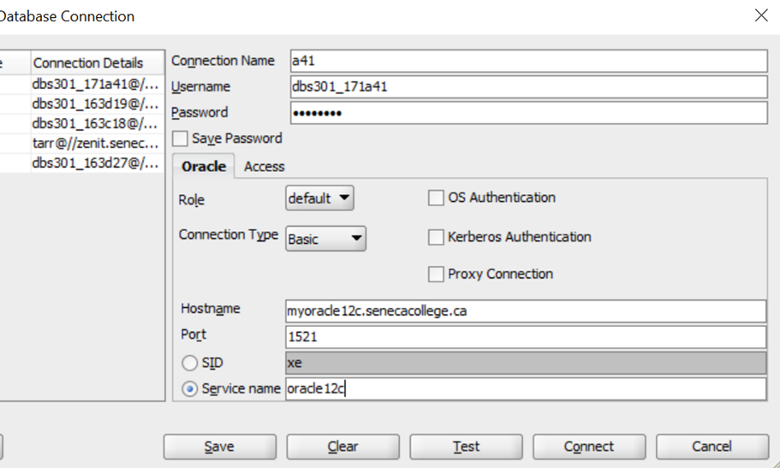
SQL Developer
Fill in the data as shown below. The connection name can be anything such as your id or initials.

Slide 8
Connection with Oracle 12c
Connection Name: Anything you want to call it: example: MyConnection or DBS211
UserName and Password: have been assigned to you
Save Password: is optional, I would save it for class purposes, but in the real world, we would not save that information
Hostname: myoracle12c.senecacollege.ca
Port: 1521
Click the Service Name radio button and enter: oracle12c
Test the connect, if successful, click Save and then Connect

Slide 9
Data versus Information
Data
Information
Raw facts
Have not yet been processed to reveal their meaning to the end user
Building blocks of information
Produced by processing raw data to reveal its meaning
Requires context
Should be accurate, relevant, and timely to enable good decision making

Slide 10
Knowledge
Data are the foundation of information, which is the bedrock of knowledge.
Knowledge implies familiarity, awareness, and understanding of information as it applies to an environment.
A key characteristic of knowledge is that “new” knowledge can be derived from “old” knowledge.

Slide 11
Data Management
Data Management is a discipline that focuses on the proper generation, storage, and retrieval of data.
Data Management is a core activity for any business, Government agency, service organization, or charity.

Slide 12
Introducing the Database
Shared, integrated computer structure that stores a collection of:
End-user data - Raw facts of interest to end user
Metadata: Data about data, which the end-user data are integrated and managed
Describe data characteristics and relationships

Slide 13
Database Management System (DBMS)
Collection of programs
Manages the database structure
Controls access to data stored in the database

Slide 14
Role of the DBMS
Intermediary between the user and the database
Enables data to be shared
Presents the end user with an integrated view of the data
Receives and translates application requests into operations required to fulfill the requests
Hides database’s internal complexity from the application programs and users

Slide 15
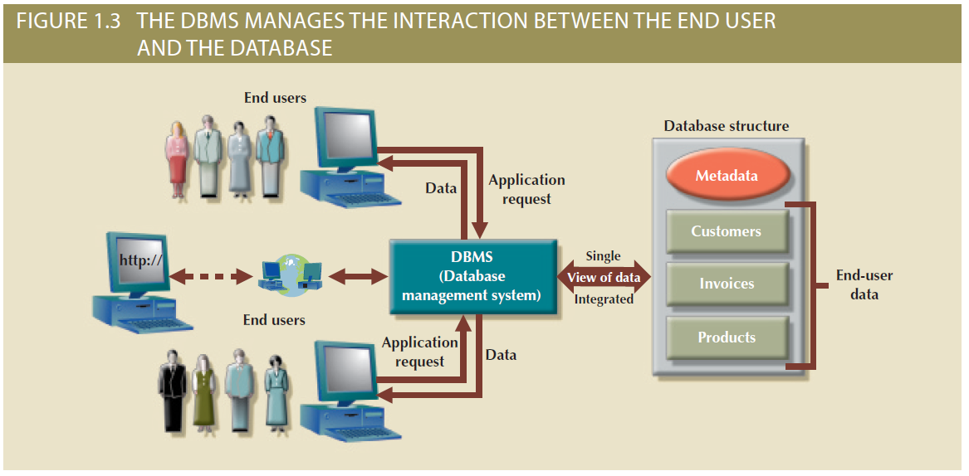
Figure 1.3 - The DBMS Manages the Interaction between the End User and the Database

Slide 16
Advantages of the DBMS
Better data integration and less data inconsistency
Data inconsistency: Different versions of the same data appear in different places
Increased end-user productivity
Improved:
Data sharing
Data security
Data access
Decision making
Data quality: Accuracy, validity, and timeliness of data

Slide 17
Summary
Data constitute the building blocks of information.
Information is produced by processing data.
Information is used to reveal the meaning of data.
Accurate, relevant, and timely information is the key to good decision making.
Good decision making is the key to organizational survival in a global environment.
To implement a database and to manage its contents, you need a database management system (DBMS). The DBMS serves as the intermediary between the user and the database. The database contains the data you have collected and “data about data,” known as metadata.

Slide 18
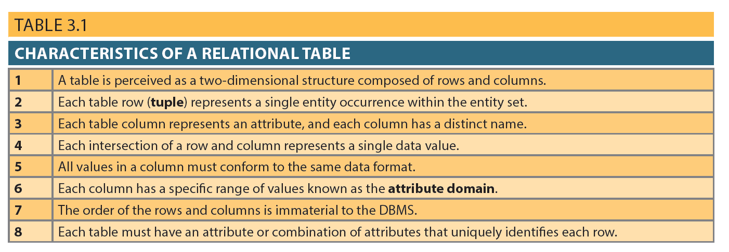
Table 3.1 - Characteristics of a Relational Table

Slide 19
Keys
Consist of one or more attributes that determine other attributes
Used to:
Ensure that each row in a table is uniquely identifiable
Establish relationships among tables and to ensure the integrity of the data
Primary key (PK): Attribute or combination of attributes that uniquely identifies any given row

Slide 20
Types of Keys
Composite key: Key that is composed of more than one attribute
Key attribute: Attribute that is a part of a key
Entity integrity: Condition in which each row in the table has its own unique identity
All of the values in the primary key must be unique
No key attribute in the primary key can contain a null

Slide 21
Types of Keys
Null: Absence of any data value that could represent:
An unknown attribute value
A known, but missing, attribute value
A inapplicable condition
Referential integrity: Every reference to an entity instance by another entity instance is valid
Secondary key: Key used strictly for data retrieval purposes

Slide 22
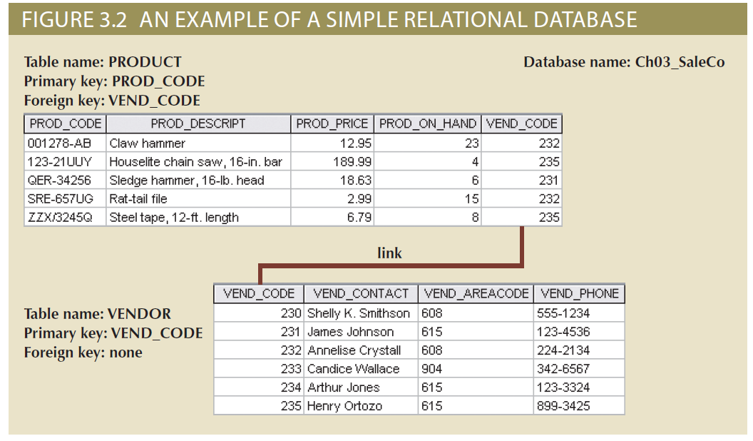
Figure 3.2 - An Example of a Simple Relational Database

Slide 23
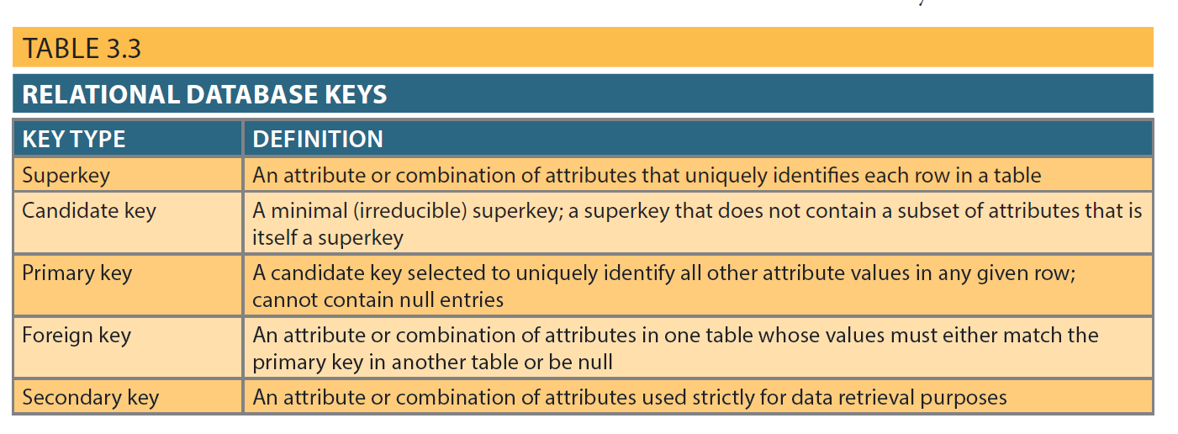
Table 3.3 - Relational Database Keys

Slide 24
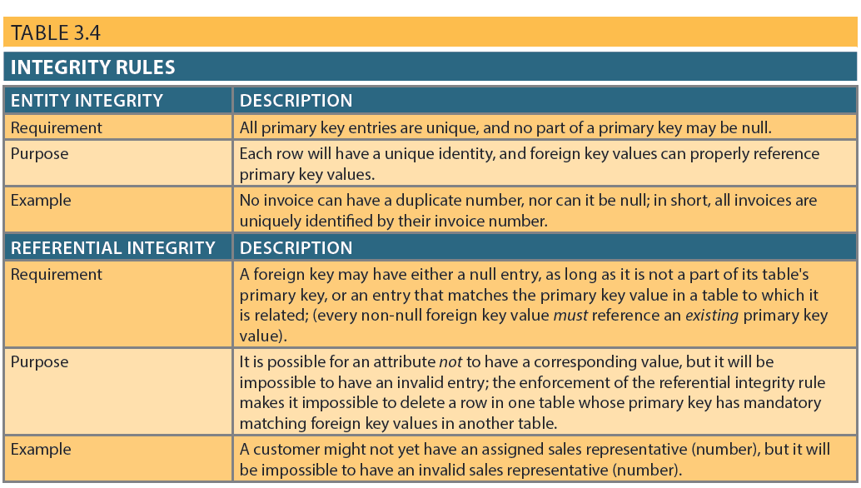
Integrity Rules

Slide 25
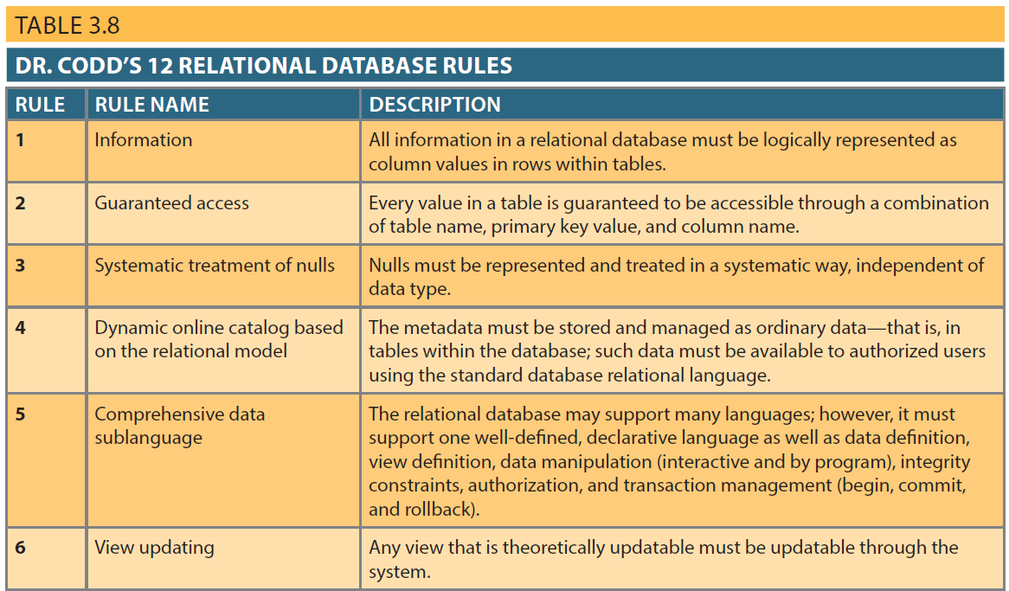
Table 3.8 – Dr. Codd’s 12 Relational Database Rules

Slide 26
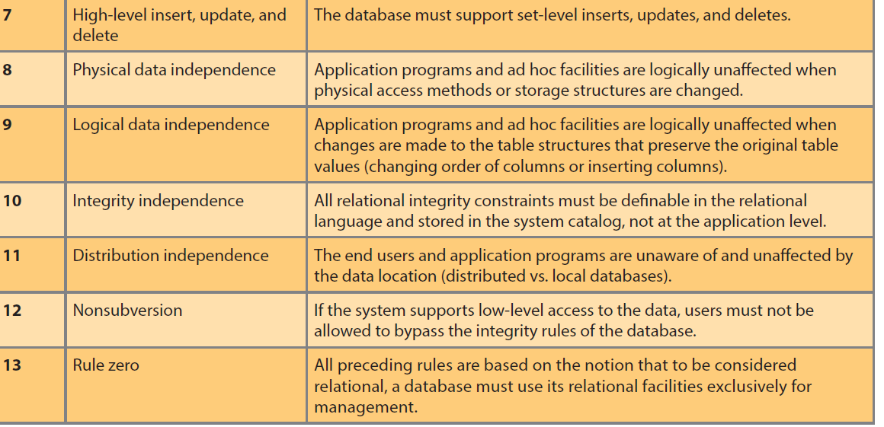
Table 3.8 – Dr. Codd’s 12 Relational Database Rules

Slide 27
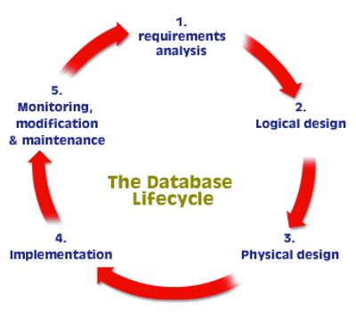
Database Lifecycle

Slide 28
Problems with un-normalized data
Update Problem
Data Inconsistency Problem
Data Redundancy Problem
Insert Problem
Deletion Problem

Slide 29
Resources and References
W3Schools.com
OracleTutorial.com Basics (Sections 1, 2, 3, 4, 9, 10, 11, 12, 13)
https://www.solarwindsmsp.com/content/types-of-database-backups
Database Systems: Design, Implementation, & Management, 12th Edition by Carlos Coronel and Steven Morris ISBN: 9781305627482

